Slide 1


Artificial Intelligence For CBSE Teachers
Workshop Under
AICTE Training and Learning Program (ATAL) Initiative
Organized by:
The LNMIIT Centre for Smart Technologies
7th to 11th June 2021

Slide 2
Part – B Computer Vision Class X

Slide 3
Computer Vision (Class X)
Introduction to Computer Vision (CV)
Applications of CV
Basic Concepts of CV
Introduction to OpenCV
Image Processing with OpenCV
Convolution
Convolutional Neural Network (CNN)

Slide 4
Introduction to Computer Vision

Slide 5
CV based games
Emoji Scavenger Hunt
https://emojiscavengerhunt.withgoogle.com/
Quick, Draw! (quickdraw.withgoogle.com)
https://deepart.io/

Slide 6
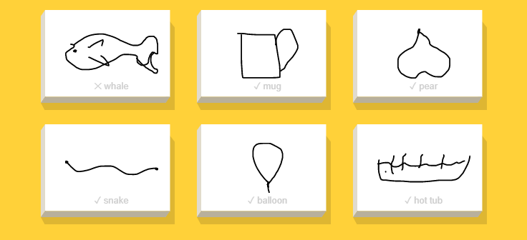

Slide 7
Applications of Computer Vision

Slide 8
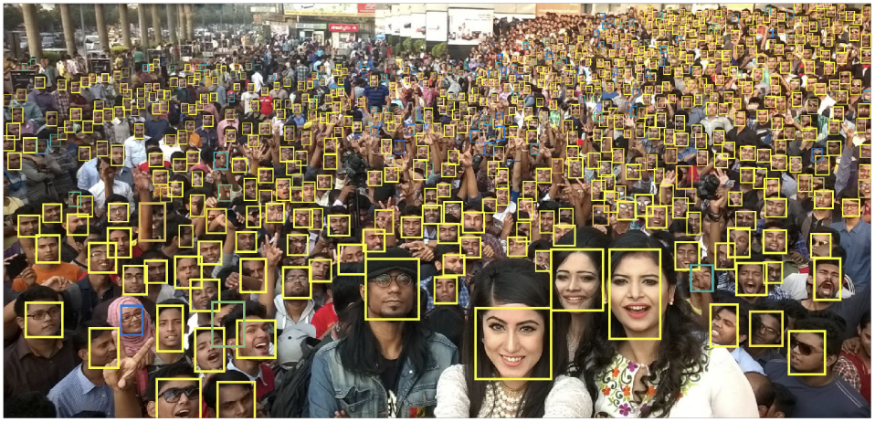
Applications of Computer Vision
Face Detection/Recognition
Facial filters
Image search
Self-driving cars
Face unlock
Medical imaging
Optical Character recognition

Slide 9
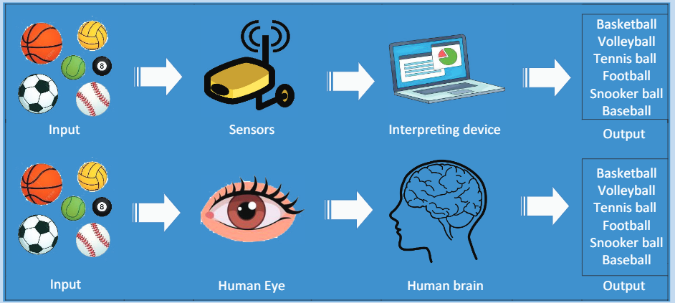
Human vision and Computer vision

Slide 10
Basic Concepts of Computer Vision

Slide 11
CV tasks
Classification: The task of classification, when it relates to images, generally refers to assigning a label to the whole image, e.g. ‘cat’.
Localization: It refer to finding where the object is in said image, usually denoted by the output of some form of bounding box around the object.

Slide 12
Object Detection: finding instances of real-world objects such as faces, bicycles, and buildings in images or videos. Object detection algorithms typically use extracted features and learning algorithms to recognize instances of an object category.
Instance Segmentation: It is the process of detecting instances of the objects, giving them a category and then giving each pixel a label on the basis of that.

Slide 13
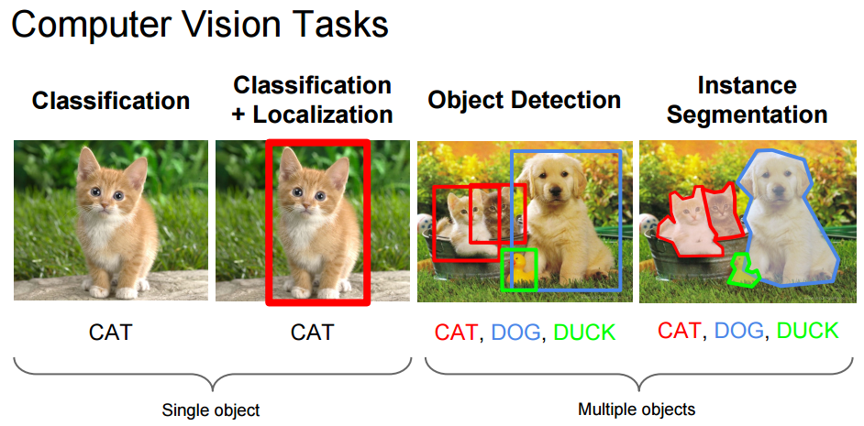

Slide 14
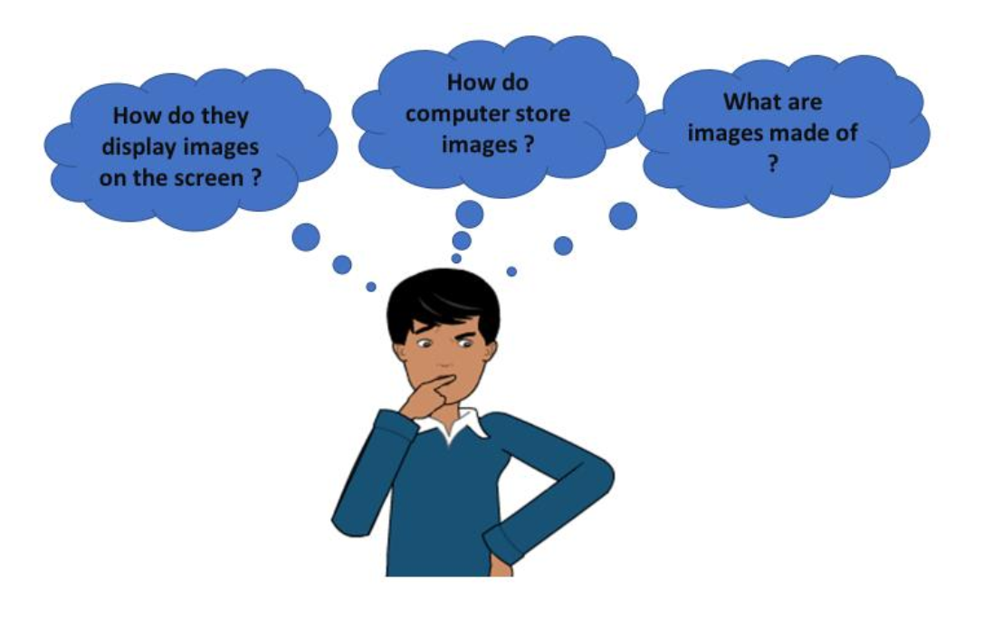
How do computers handle images?

Slide 15
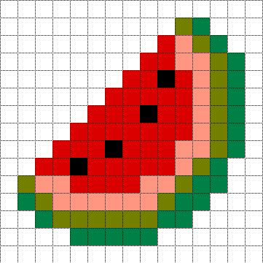
Pixel
The word “pixel” means a picture element.
Every photograph, in digital form, is made up of pixels.
They are the smallest unit of information that make up a picture.
Usually round or square, they are typically arranged in a 2-dimensional grid.

Slide 16
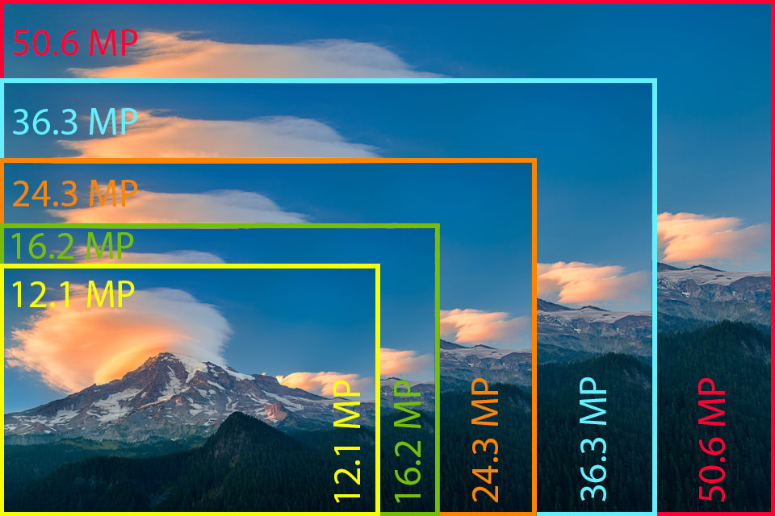
Resolution
The number of pixels in an image is sometimes called the resolution.
When the term is used to describe pixel count, one convention is to express resolution as the width by the height, for example a monitor resolution of 1280×1024.
This means there are 1280 pixels from one side to the other, and 1024 from top to bottom.

Slide 17
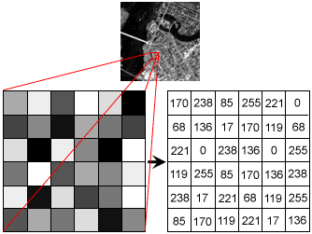
Pixel values
Each of the pixels that represents an image stored inside a computer has a pixel value which describes how bright that pixel is, and/or what colour it should be.
This number is stored as an 8-bit integer giving a range of possible values from 0 to 255.
Typically, zero is to be taken as no colour or black and 255 is taken to be full colour or white.
For colored images, we have 3 values of 8 bit each of R, G, and B.

Slide 18
What is a digital image?
An image is defined as a two-dimensional function,F(x,y), where x and y are spatial coordinates, and the amplitude of F at any pair of coordinates (x,y) is called the intensity of that image at that point.
When x,y, and amplitude values of F are finite, we call it a digital image.
Threfore, an image can be defined by a two-dimensional array specifically arranged in rows and columns.

Slide 19
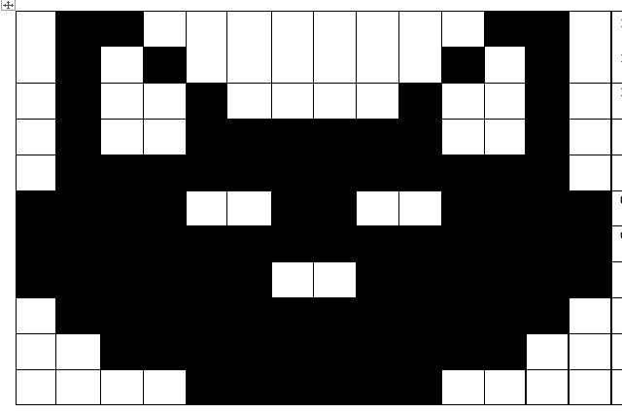
Binary images
The binary image as its name suggests, contain only two pixel elements i.e 0 & 1,where 0 refers to black and 1 refers to white.
This image is also known as Monochrome

Slide 20
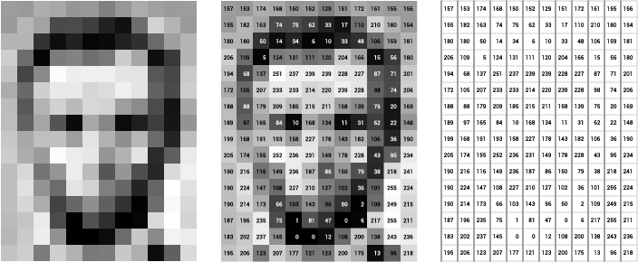
Grayscale Images
Grayscale images are images which have a range of shades of gray without apparent colour.
The darkest possible shade is black, which is the total absence of colour or zero value of pixel.
The lightest possible shade is white, which is the total presence of colour or 255 value of a pixel .

Slide 21
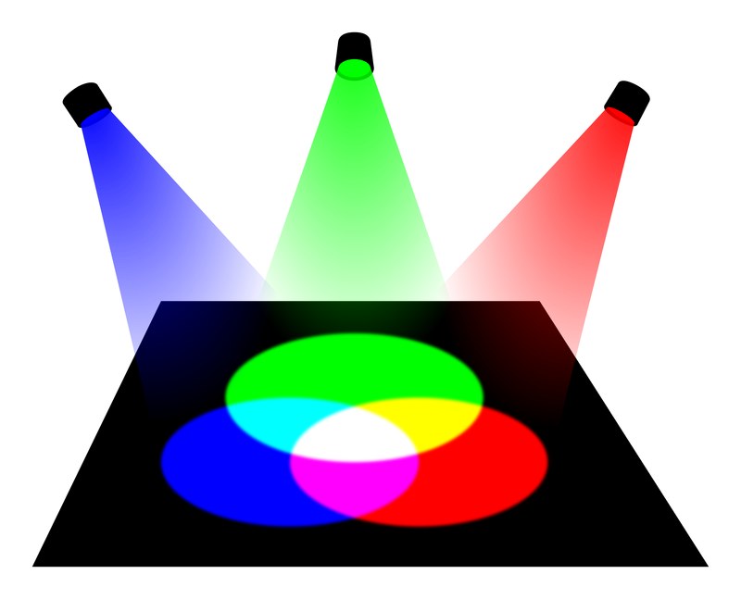
RGB (colored) images
These images are made up of three primary colours Red, Green and Blue.
All the colours that are present can be made by combining different intensities of red, green and blue

Slide 22
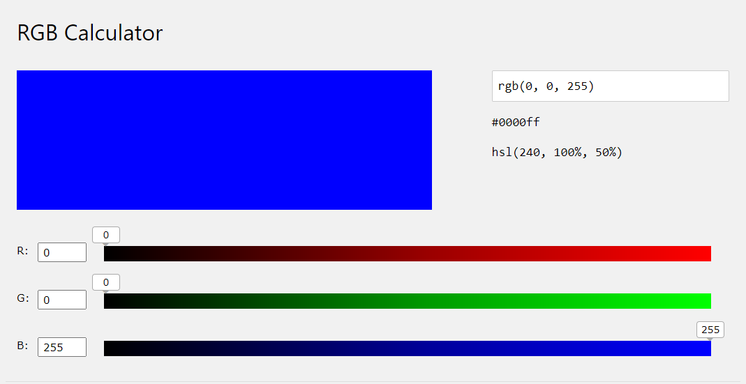
Lets explore RGB images
https://www.w3schools.com/colors/colors_rgb.asp

Slide 23
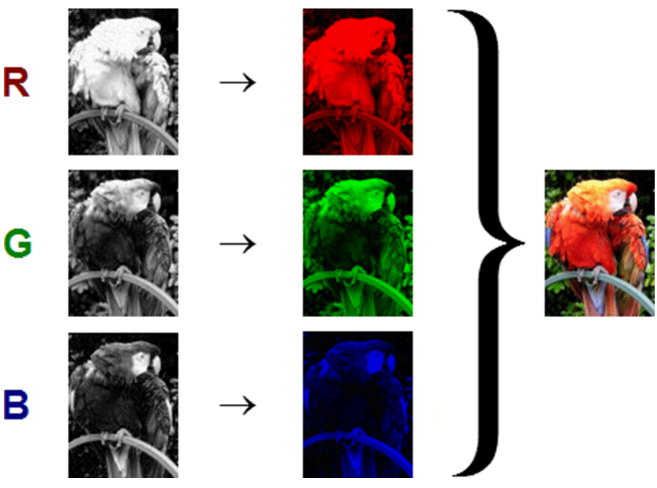

Slide 24
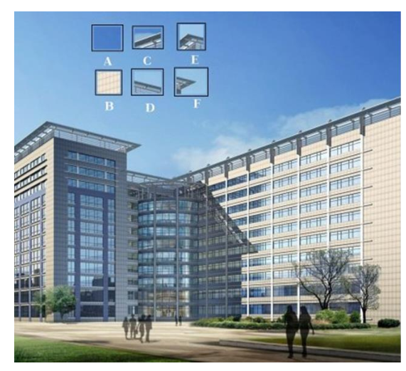
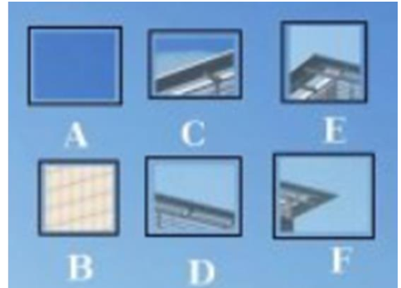
Image feature
A feature is a piece of information about the content of an image.
Typically about whether a certain region of the image has certain properties.
Features may be specific structures in the image such as points, edges or objects.
Features are related to motion in image sequences, or to shapes defined in terms of curves or boundaries between different image regions.

Slide 25
Introduction to OpenCV

Slide 26

OpenCV
OpenCV is an open-source library, which is used for computer vision in Artificial intelligence, Machine Learning, face recognition, etc.
OpenCV supports a wide variety of programming languages like Python, C++, Java, etc
It can process images and videos to identify objects, faces, or even the handwriting of a human.

Slide 27
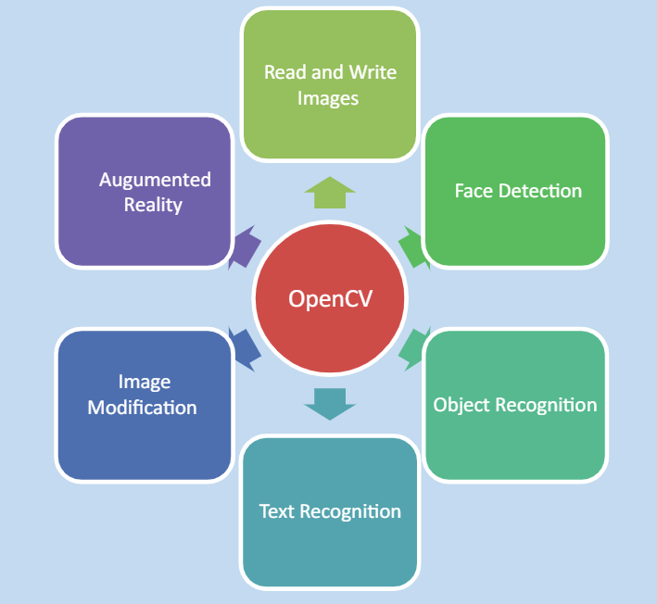
Applications of OpenCV

Slide 28
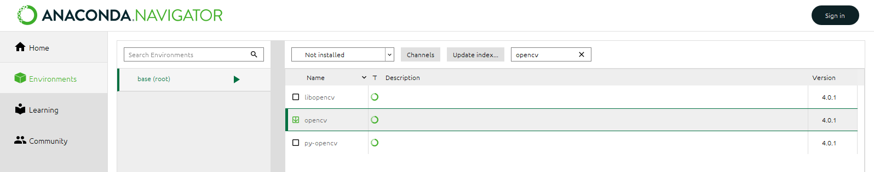
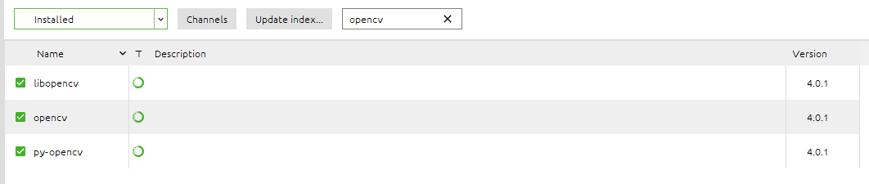
Installing OpenCV
OpenCV does not come preinstalled with Anaconda
Install it from Anaconda Navigator

Slide 29
Installing
Else use anaconda prompt and run the command
Pip install opencv-python
Or
Run the same commans using Jupyter Notebook

Slide 30
Basic Image Operations with OpenCV
Library import: import cv2 or import cv2 as cv
Function | Description
imread | Read the image
imshow | Show image in a window
imwrite | Save the image at a location
cvtColor | convert image to different color schemes
resize | Convert the image to a different size.
split | Split the R, G , B channels of the image
merge | Merge the RGB channels of the image

Slide 31
Lets get started
We’ll work in Jupyter notebook.
You can also work in python without anaconda
Keep the images in the same folder as your code or a folder inside it

Slide 32
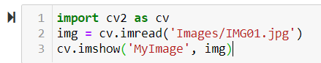
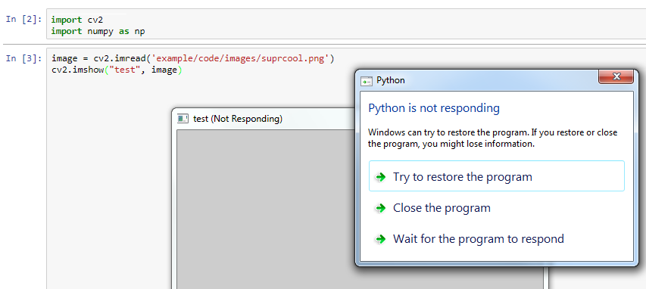
Precautions with Jupyter Notebook
If we try a simple code:
It will not work as the new window will not open
We need to add two more lines of code whenever we work with Jupyter Notebook.

Slide 33
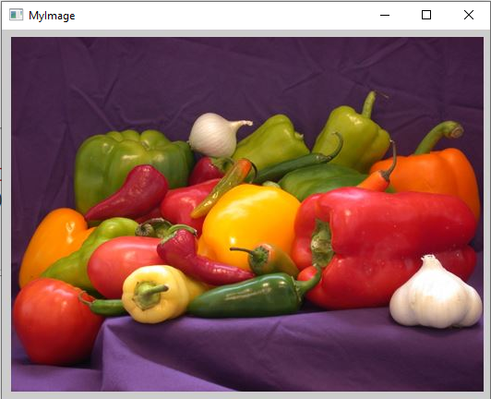
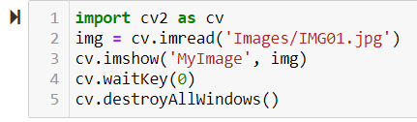
Complete code

Slide 34
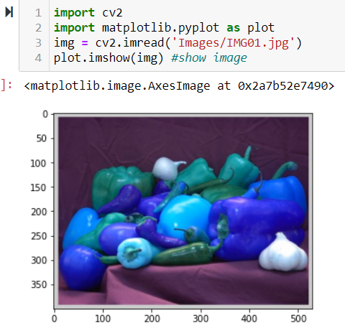
imshow is also possible with matplotlib

Slide 35
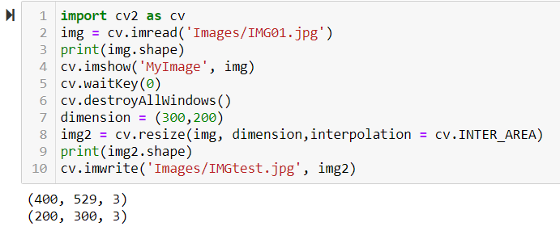
Resize

Slide 36
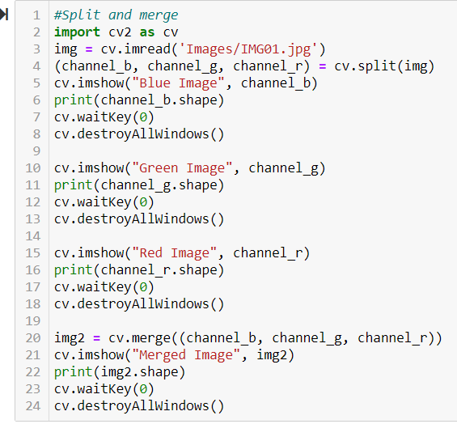
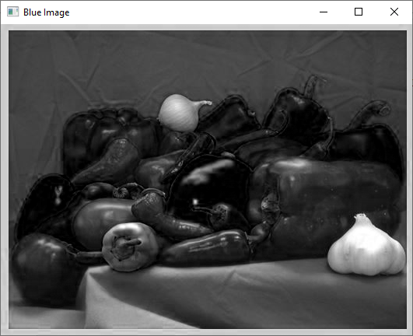
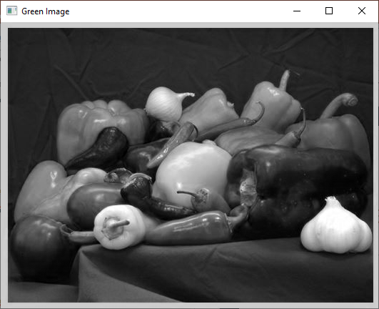
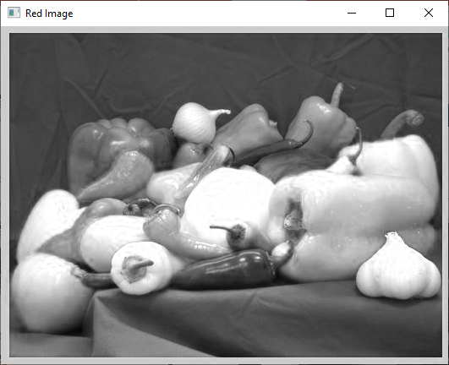
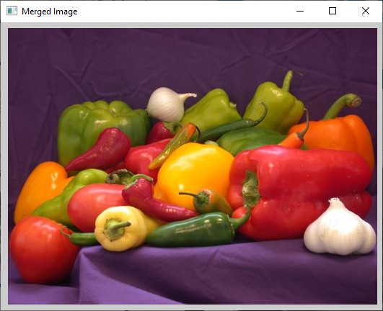
Split and Merge

Slide 37
Display only one color
If we want to display only the blue component (not in grayscale), then we will first split the image in three colors.
Then create a matrix of zeros of the size of image
Merge the color component with 2 matrixes of zeroes.

Slide 38
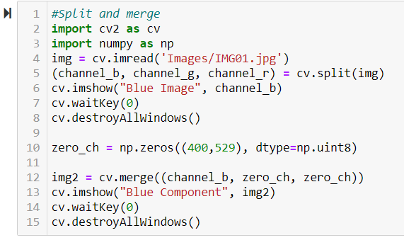
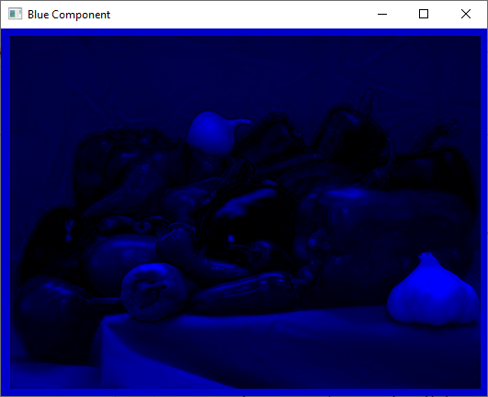

Slide 39
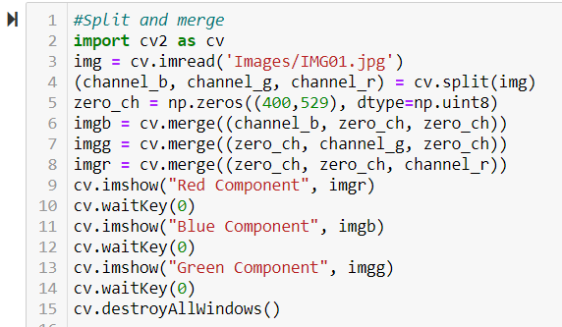
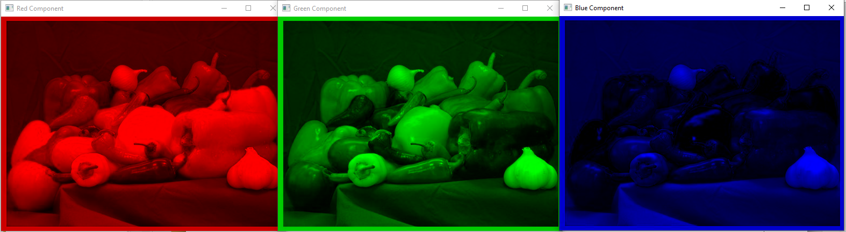

Slide 40
Convolution

Slide 41
Convolution
Convolution is a mathematical operation on two functions (f and g) that produces a third function that expresses how the shape of one is modified by the other.
The term convolution refers to both the result function and to the process of computing it.
It is defined as the integral of the product of the two functions after one is reversed and shifted.
The integral is evaluated for all values of shift, producing the convolution function.

Slide 42
Examples
Consider two sequences f= {1, 2, 3, 4}, and g={5, 4, 3}
Now to compute the convolution, reverse any sequence and let us reverse g and it becomes {3, 4, 5}
Now, keep f at its place and slide g from left to right and calculate the sum of products for each move.
For two arrays of sizes n and m, the output length is n+m-1.

Slide 43
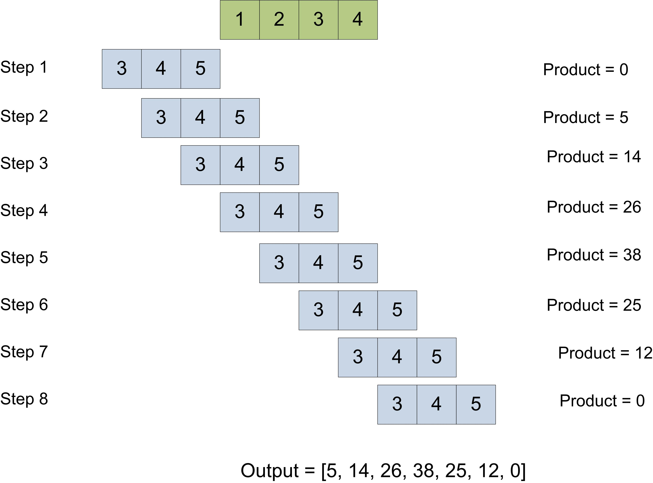

Slide 44
Matrix (2-D) Convolution
Normally used in image processing for application like filtering, edge detection and smoothing.
One matrix is image matrix.
The other is called the Kernel (which performs specific function).
The convolution will produce the desired output

Slide 45
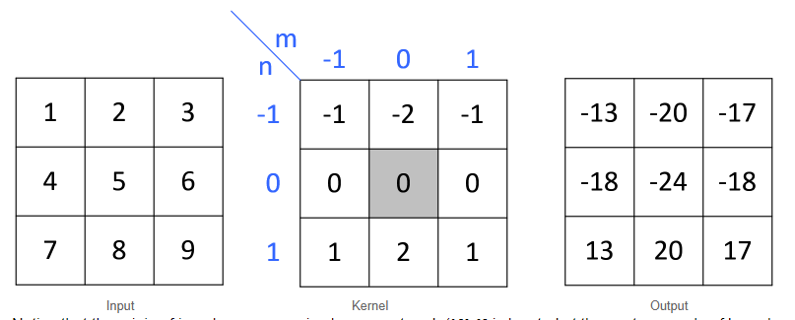
2-D convolution

Slide 46
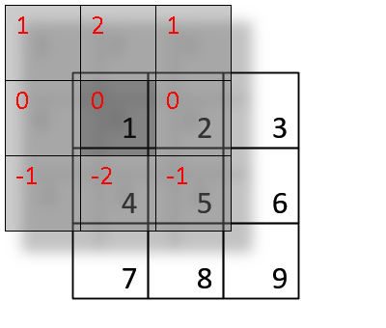
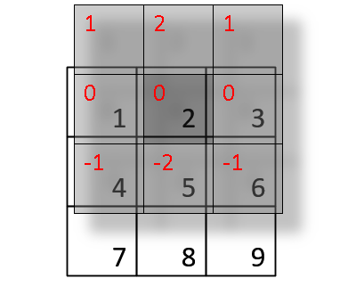
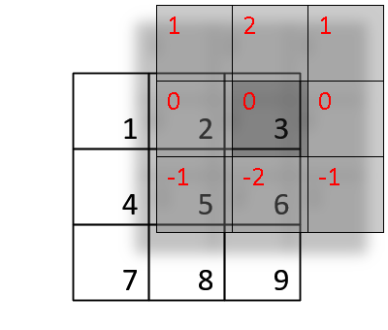
Step wise calculation

Slide 47
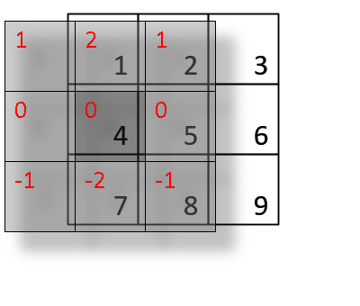
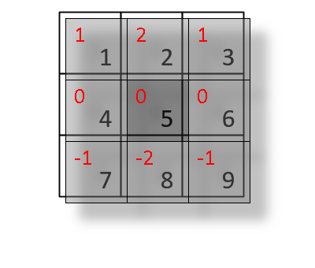
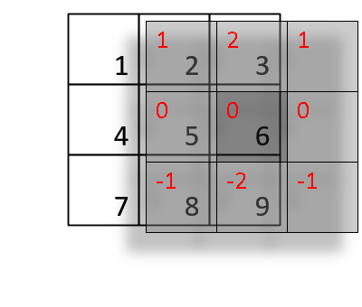
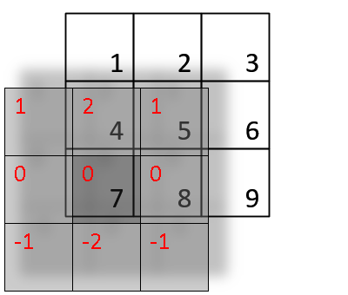
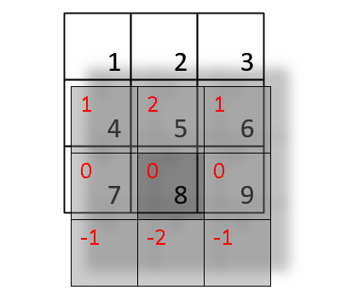
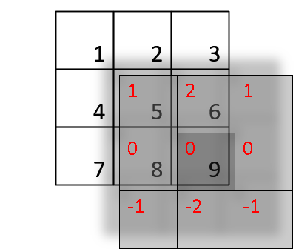

Slide 48
Convolutional Neural Networks (CNN)

Slide 49
Convolutional Neural Network
A Convolutional Neural Network (ConvNet/CNN) is a Deep Learning algorithm which can take in an input image, assign importance (learnable weights and biases) to various aspects/objects in the image and be able to differentiate one from the other.
The pre-processing required in a ConvNet is much lower as compared to other classification algorithms.
While in primitive methods filters are hand-engineered, with enough training, ConvNets have the ability to learn these filters/characteristics.

Slide 50

Architecture

Slide 51
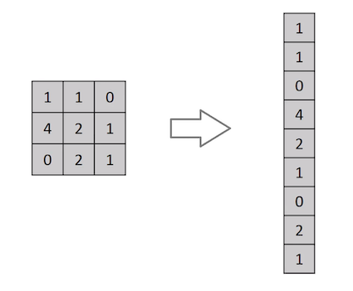
Different from other NN
Do not convert images into vectors or arrays
A ConvNet is able to successfully capture the Spatial and Temporal dependencies in an image through the application of relevant filters.

Slide 52

Convolutional layer
Input image
I = 5x5x1
Kernel K as a 3x3x1 matrix.
Output is 3x3x1

Slide 53

For RGB images

Slide 54
Why more layers for convolution
The objective of the Convolution Operation is to extract the high-level features such as edges, from the input image.
ConvNets need not be limited to only one Convolutional Layer.
Conventionally, the first ConvLayer is responsible for capturing the Low-Level features such as edges, color, gradient orientation, etc. With added layers, the architecture adapts to the High-Level features as well,

Slide 55

Pooling layer
Pooling layer is responsible for reducing the spatial size of the Convolved Feature.
This is to decrease the computational power required to process the data through dimensionality reduction.
Furthermore, it is useful for extracting dominant features

Slide 56

Types of pooling
Max pooling: It returns the maximum value from the portion of the image covered by the Kernel. Max Pooling also performs as a Noise Suppressant
Average Pooling: returns the average of all the values from the portion of the image covered by the Kernel.

Slide 57
Classification
Adding a Fully-Connected layer is a (usually) cheap way of learning non-linear combinations of the high-level features as represented by the output of the convolutional layer.
The Fully-Connected layer is learning a possibly non-linear function in that space.
Over a series of epochs, the model is able to distinguish between dominating and certain low-level features in images and classify them using the Softmax Classification technique.

Slide 58
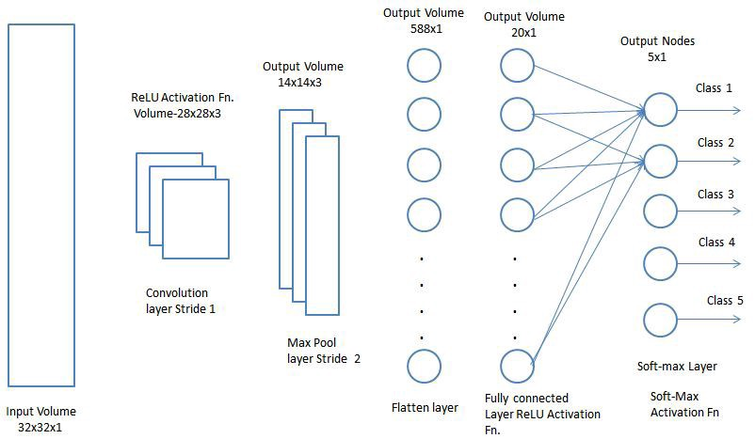

Slide 59
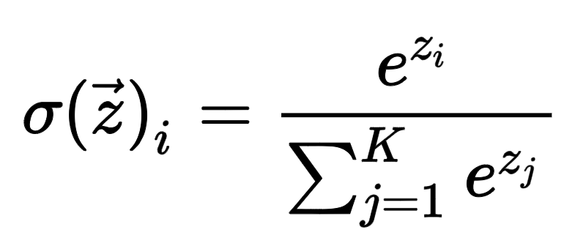
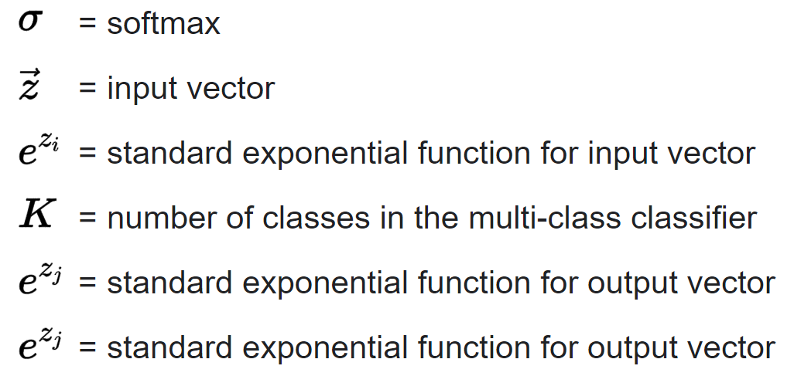
Softmax function

Slide 60
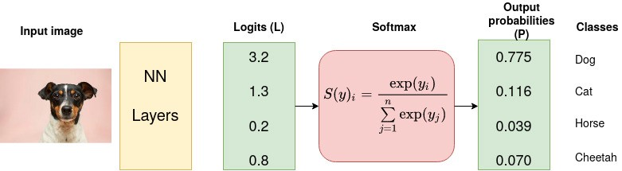
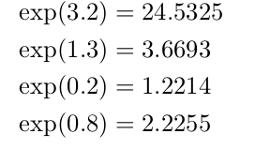

Example

Slide 61
Demo
https://www.cs.ryerson.ca/~aharley/vis/conv/flat.html
Select the marker and write and number

Slide 62


